Slide 1
Who is the Real Jesus?:
Talking with Jehovah’s Witnesses, Mormons, and Skeptics about Jesus’ Most Audacious Claim

Slide 2
Gen. 19:24
²⁴ Then the LORD rained on Sodom and Gomorrah sulfur and fire from the LORD out of heaven.

Slide 3
Gen. 19:24
²⁴ Then the LORD (YHWH) rained on Sodom and Gomorrah sulfur and fire from the LORD (YHWH) out of heaven.

Slide 4
Some things we know about God
God is One

Slide 5
Some things we know about God
God is One
Deut 6:4 “Hear, O Israel: The LORD our God, the LORD is one.”

Slide 6
Some things we know about God
God is One
Deut 6:13-14 “It is the LORD your God you shall fear...you shall NOT go after other gods”

Slide 7
Some things we know about God
God is One
Is 42:8 “I am the LORD; that is my name;my glory I give to no other,

Slide 8
Some things we know about God
God is One
God cannot be seen

Slide 9
Some things we know about God
God is One
God cannot be seen
Ex. 33:20 But He said, "You cannot see My face, for no man can see Me and live!

Slide 10
Some things we know about God
God is One
God cannot be seen
John 1:18a-No one has seen God at any time

Slide 11
Some things we know about God
God is One
God cannot be seen
John 6:46 "Not that anyone has seen the Father, except the One who is from God; He has seen the Father.”

Slide 12
Diversity in Unity
Angel of the LORD

Slide 13
Gen 48:15-16
¹⁵ Then he blessed Joseph and said,
“May the God before whom my [family] walked
the God who has been my shepherd...
¹⁶ the Angel who has redeemed me from all harm—
may he bless these boys.

Slide 14
Judges 6
¹¹ Now the angel of the LORD came and sat under the terebinth...¹² And the angel of the LORD appeared to [Gideon] and said to him, “The LORD is with you”... [He responds],“But now the LORD has forsaken us and given us into the hand of Midian.” ¹⁴And the LORD turned to him and said, “Go in this might of yours

Slide 15
Judges 6
²¹ Then the angel of the LORD reached out the tip of the staff that was in his hand and touched the meat and the unleavened cakes. And fire sprang up from the rock and consumed the meat and the unleavened cakes. And the angel of the LORD vanished from his sight.

Slide 16
Judges 6
²² Then Gideon perceived that he was the angel of the LORD. And Gideon said, ^{m}“Alas, O Lord GOD! For now I have seen the angel of the LORD face to face.” ²³ But the LORD said to him, ^{n}“Peace be to you. Do not fear; you shall not die.”

Slide 17
Diversity in Unity
Angel of the LORD
Word

Slide 18
Gen 15:1
“After these things the word of the LORD came to Abram in a vision...”

Slide 19
1 Sam 3:1
Now the boy Samuel was ministering to the LORD in the presence of Eli. And the word of the LORD was rare in those days; there was no frequent vision.

Slide 20
1 Sam 3:10
And the LORD came and stood, calling as at other times...

Slide 21
1 Sam 3:19-21
And Samuel grew, and the LORD was with him and let none of his words fall to the ground. ²⁰ And all Israel from Dan to Beersheba knew that Samuel was established as a prophet of the LORD.

Slide 22
1 Sam 3:19-21
²¹ And the LORD appeared again at Shiloh, for the LORD revealed himself to Samuel at Shiloh [by/through/as] the word of the LORD.

Slide 23
Jer 1:4, 9
⁴ The word of the LORD came to me...⁹ Then the LORD reached out his hand and touched my mouth

Slide 24
Diversity in Unity
Angel of the LORD
Word
Glory

Slide 25
Ezek 1
1: 1 ...I saw visions of God... ³ the word of the LORD came...^{26b} high above on the throne was a figure like that of a man… ^{28b} the likeness of the glory of the LORD

Slide 26
Ezek 3:23b
The glory of the LORD was standing there, like the glory I had seen by the Kebar River, and I fell facedown

Slide 27
Diversity in Unity
Angel of the LORD
Word
Glory
Son of man

Slide 28
Dan 7:9, 13-14
As I looked, thrones were set in place, and the Ancient of Days took his seat...and there before me was one like a son of man, coming with the clouds of heaven.

Slide 29
Dan 7:9, 13-14
He approached the Ancient of Days and was led into his presence. He was given authority, glory and sovereign power; all people, nations and men of every language worshiped him.

Slide 30
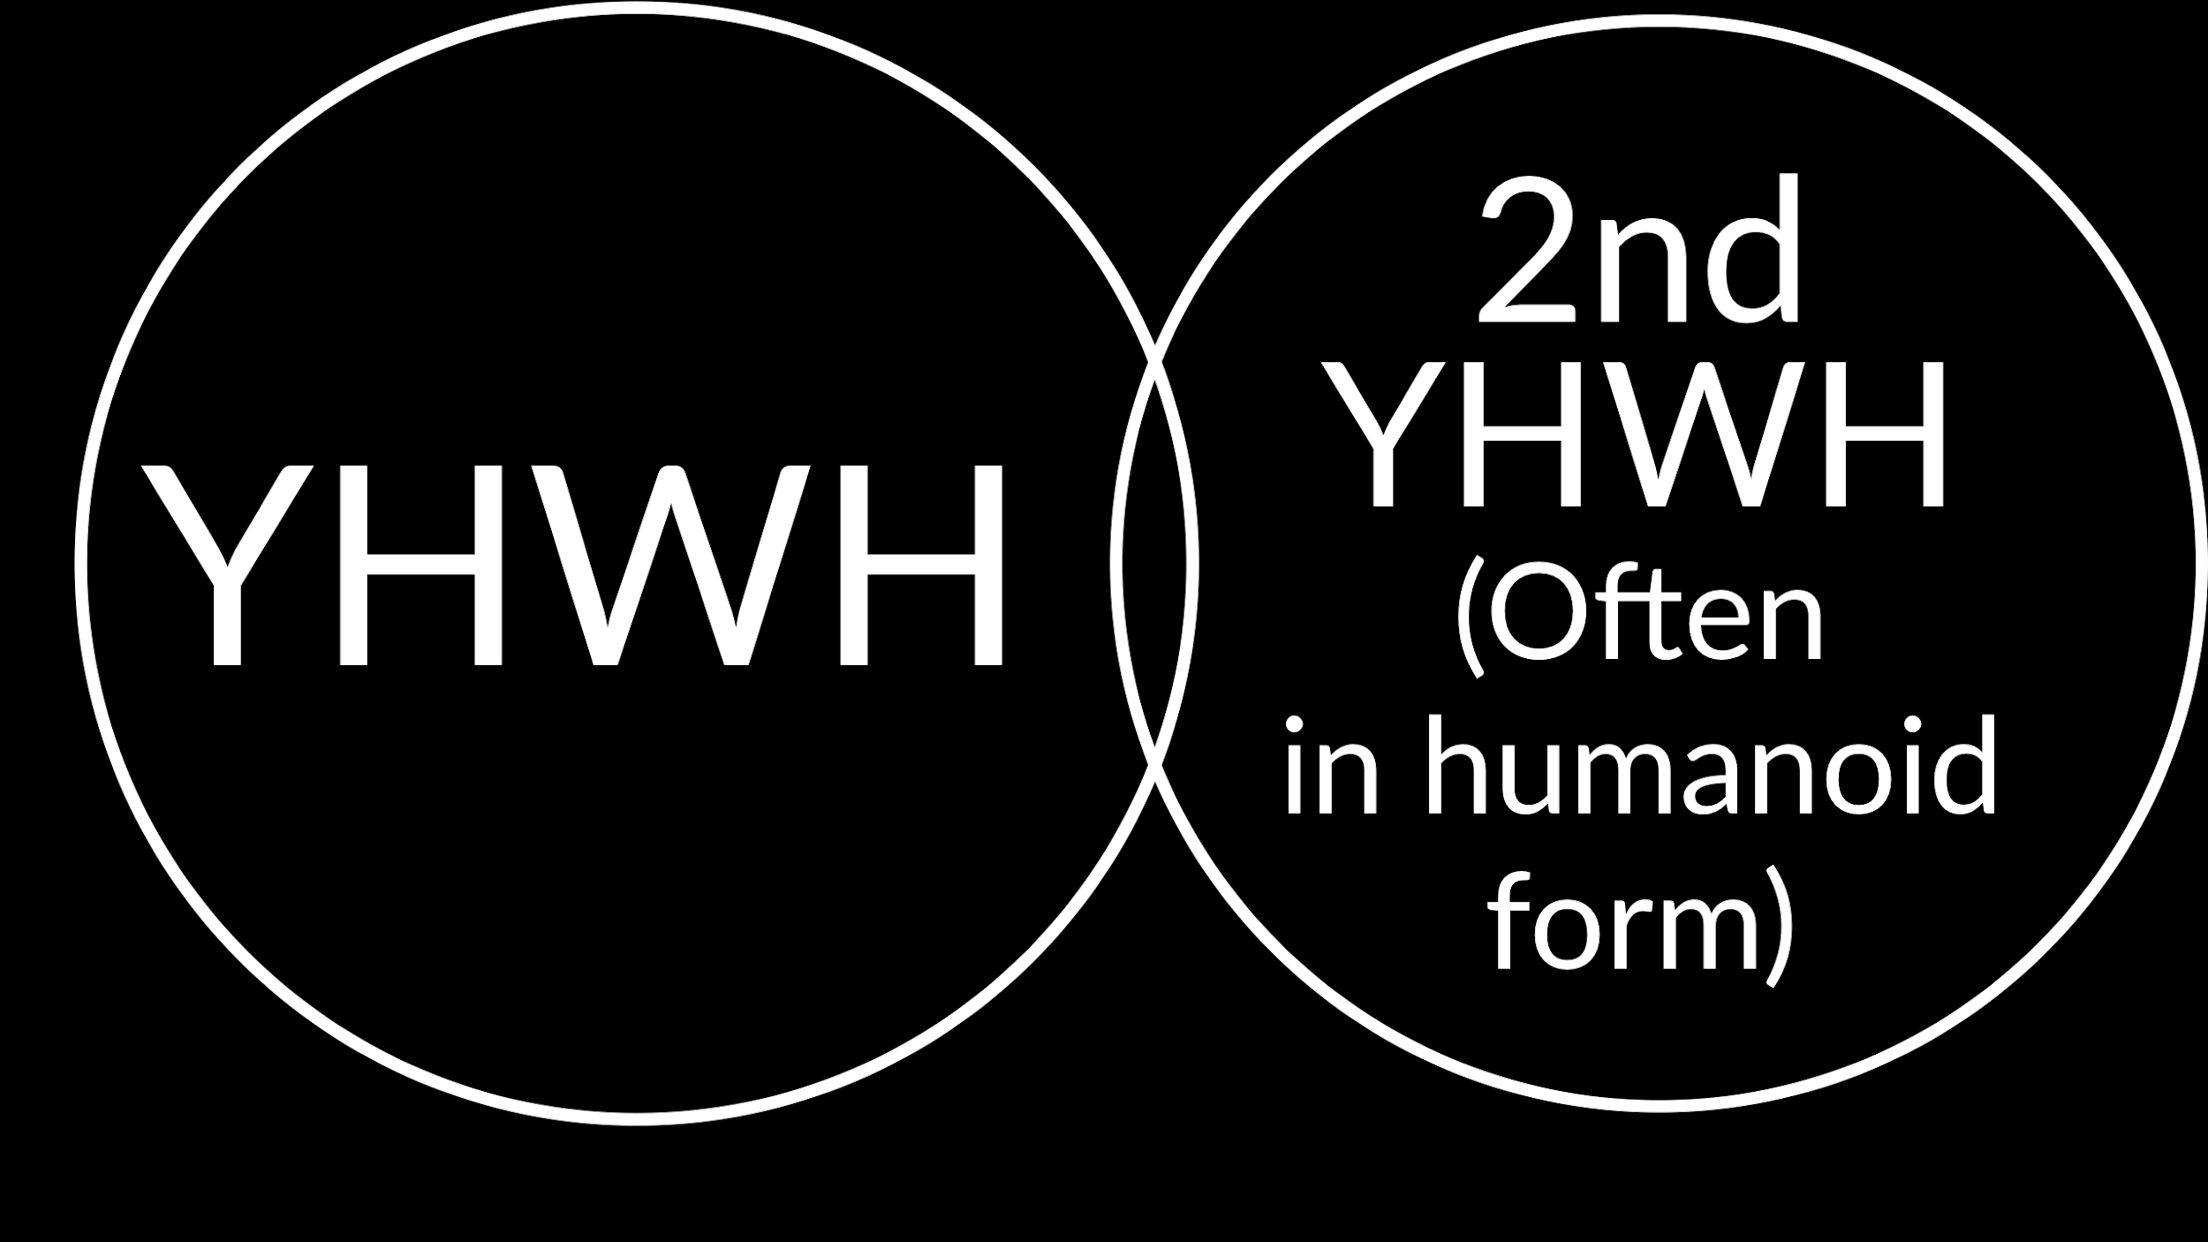

Slide 31
Summary:
The Angel of the LORD, the Word, The Glory, and the Son of Man were interpreted to be a 2nd visible YHWH by many 1st century Jews.

Slide 32
John 1:1-3
In the beginning was the Word, and the Word was with God, and the Word was God. ² He was in the beginning with God. ³ All things were made through him, and without him was not any thing made that was made.

Slide 33
John 1:14
And the Word became flesh and dwelt among us, and we have seen his glory, glory as of the only Son from the Father, full of grace and truth.

Slide 34
What Jehovah’s Witnesses Believe
God (the Father) alone is God and worthy of worship alone
Jesus is God’s 1st creation

Slide 35


Slide 36
John 1:1-3
In the beginning was the Word, and the Word was with God, and the Word was God. ² He was in the beginning with God. ³ All things were made through him, and without him was not any thing made that was made.

Slide 37
John 1:14
And the Word became flesh and dwelt among us, and we have seen his glory, glory as of the only Son from the Father, full of grace and truth.

Slide 38
What LDS (Mormons) Believe
The Father and Jesus (and Holy Spirit) are all Gods, but entirely separate.
All humans can become a God
Jesus is literally the offspring (as we are) of the Father and Heavenly Mother

Slide 39
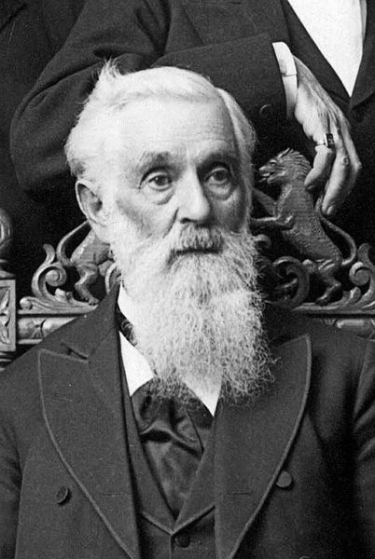
President Lorenzo Snow
As man now is, So God once was; as God now is, so man may be

Slide 40


Slide 41
What Many Skeptics Believe:
While the NT as a whole clearly teaches Jesus as divine. It developed over time and eventually the Jesus is divine side “won.”

Slide 42
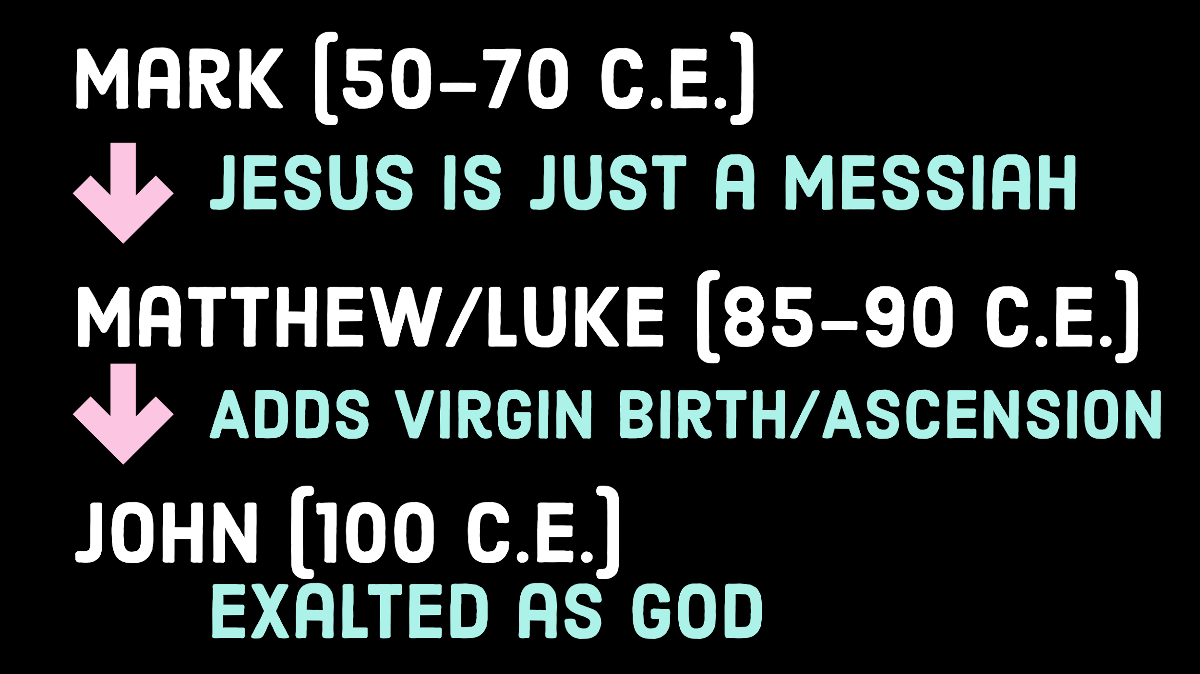

Slide 43
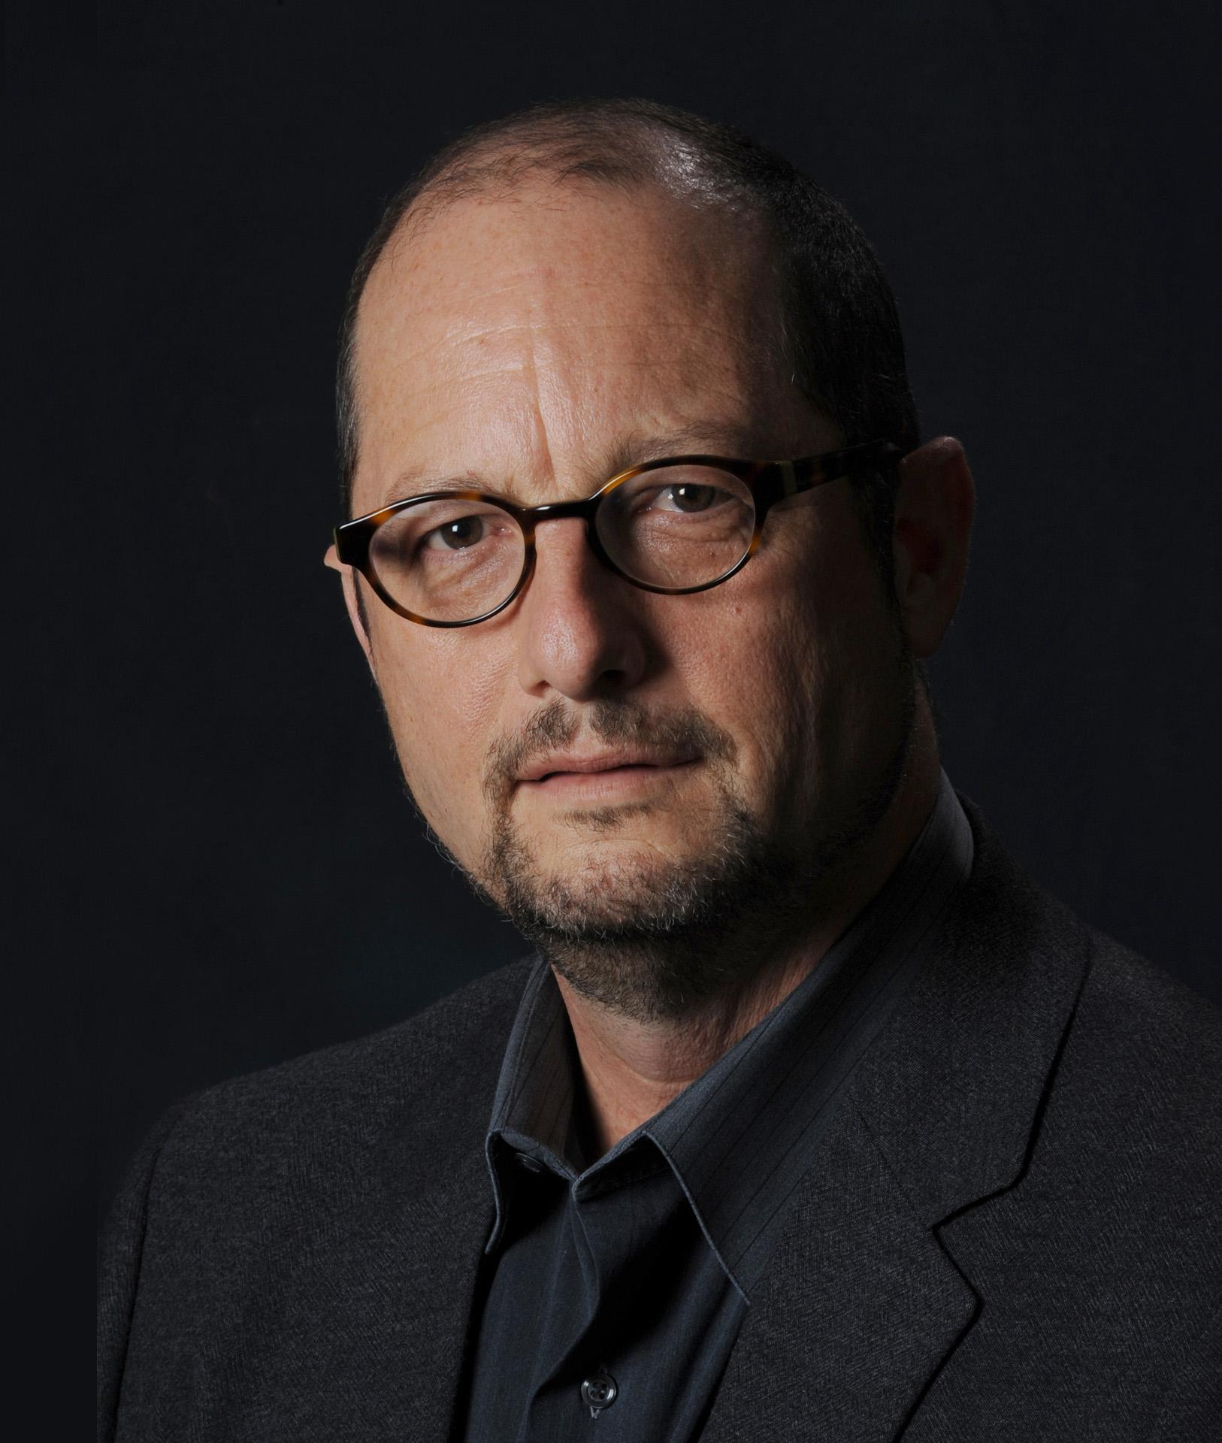
Bart Ehrman
I should stress...Mark is not concerned to show whether Christ is co-eternal with the Father, equal with him, of the same essence as him.

Slide 44
Bart Ehrman
These questions never once occurred to the Christians of the first century.

Slide 45
Jesus isn’t Divine in Mark?

Slide 46
Mk 1:2-3
³A voice of one calling in the desert, ‘Prepare the way of the Lord, make straight his paths’”
²It is written, “I will send my messenger ahead of you, who will prepare your way

Slide 47
Mk 1:2 and Mal 3:1
²It is written, “I will send my messenger ahead of you, who will prepare your way
3:1 See, I will send my messenger who will prepare the way before me.

Slide 48
Mk 1:3 and Is 40:3
³A voice of one calling in the desert, ‘Prepare the way of the Lord, make straight his paths’”
40:3 A voice of one calling, “...make straight in the wilderness a highway for our God

Slide 49
Mk 2:5-7
[Jesus] said to the paralytic, “Son, your sins are forgiven.” ⁶ Now some of the scribes were sitting there, questioning in their hearts, ⁷ “Why does this man speak like that? He is blaspheming! Who can forgive sins but God alone?”

Slide 50
Mk 6-Jesus Walking on the Water
he came to them, walking on the sea. He meant to pass by them, ⁴⁹ but when they saw him walking on the sea they thought it was a ghost, and cried out, ⁵⁰ for they all saw him and were terrified. But immediately he spoke to them and said, “Take heart; it is I. Do not be afraid.”

Slide 51
Mk 6-Jesus Walking on the Water
He walks on sea
He intends to pass by them
Disciples don’t recognize him
“Take courage! I AM. Don’t be afraid

Slide 52
Compare Job 9:8, 11
⁸ [God] who alone ^{f}stretched out the heavens and walks the waves of the sea;
...
¹¹ Behold, he passes by me, and I ^{l}see him not; he moves on, but I do not perceive him.

Slide 53
Mk 14:61-64
Again the high priest asked him, “Are you the Christ, the Son of the Blessed?” ⁶² And Jesus said, “I am, and you will see the Son of Man seated at the right hand of Power, and coming with the clouds of heaven.”

Slide 54
Mk 14:61-64
⁶³ And the high priest tore his garments and said, “What further witnesses do we need? ⁶⁴ You have heard his blasphemy.

Slide 55
A Better Story?

